Slide 1

Let’s start with Allah Yaar
Bs in Computer Science

Slide 2
The Internet Protocol Suite (TCP/IP)
The Internet Protocol Suite, or TCP/IP model, is the foundation for communication on the internet. It structures how data is transmitted, ensuring interoperability between diverse systems. Unlike the OSI model, which has seven layers, TCP/IP organizes functions into four layers, emphasizing practical implementation.
Layers and Their Roles:
Link Layer (Physical + Data Link in OSI):
Handles hardware-based transmission and addressing.
Responsible for framing, error detection, and accessing network media.

Slide 3
The Internet Protocol Suite (TCP/IP)
Internet Layer (Network in OSI):
Facilitates logical addressing (IP addresses) and routing.
Transport Layer:
Manages end-to-end communication, including reliability and flow control.
Application Layer:
Supports user-facing network services like email, file transfer, and web browsing.
Why It’s Important:
Ensures modularity and scalability for global networks.
Allows devices with varied architectures to communicate seamlessly.

Slide 4
The Internet Protocol Suite (TCP/IP)
Example:
Imagine uploading a video to YouTube:
The Application Layer (using HTTP/HTTPS) handles your video’s metadata and interface with the server.
The Transport Layer (TCP) segments your video data into packets and ensures they arrive in order.
The Internet Layer (IP) routes these packets to YouTube’s servers.
The Link Layer transmits them over physical media, such as Wi-Fi or fiber optics.

Slide 5
Link Layer
The Link Layer ensures physical data transmission across a local network. It combines the physical transmission medium and protocols managing the direct link between devices.
Detailed Responsibilities:
Data Framing: Divides network-layer packets into smaller frames for transmission.
Media Access Control (MAC): Regulates access to shared media (e.g., Wi-Fi, Ethernet) using MAC addresses.

Slide 6
Link Layer
Error Detection: Implements mechanisms like Cyclic Redundancy Check (CRC) to detect transmission errors.
Hardware Interface: Directly interacts with NICs (Network Interface Cards), cables, or wireless transmitters.
Protocols:
Ethernet (IEEE 802.3): Used in wired networks.
Wi-Fi (IEEE 802.11): Wireless transmission.
PPP (Point-to-Point Protocol): Used in direct links like DSL.

Slide 7
Link Layer
Example:
On a LAN, when a laptop sends data to a printer over Wi-Fi, the Link Layer uses the printer’s MAC address to transmit the frames to the correct device.

Slide 8
Internet Layer
The Internet Layer defines how data is routed across networks, ensuring packets reach the intended destination, even if they traverse multiple routers or networks.
Detailed Responsibilities:
Routing: Determines the best path for packet delivery using routing algorithms like OSPF or RIP.
Logical Addressing: Uses IP addresses to identify devices uniquely.
Packet Fragmentation and Reassembly: Divides large packets for compatibility with smaller MTUs.

Slide 9
Internet Layer
Protocols:
IPv4: Most widely used, with 32-bit addresses.
IPv6: Newer protocol supporting 128-bit addresses to address IP exhaustion.
ICMP: Facilitates diagnostics and error reporting (e.g., "ping" for connectivity tests).
Example:
When you perform a video call, the Internet Layer ensures packets containing audio and video data are routed across multiple ISPs to the recipient, even if the recipient is in another country.

Slide 10
Transport Layer
The Transport Layer oversees reliable and efficient delivery of data between devices, ensuring error-free communication.
Detailed Responsibilities:
Connection Management: Establishes, maintains, and terminates sessions (e.g., TCP’s three-way handshake).
Data Segmentation: Splits application data into segments with sequence numbers for reordering.
Error Recovery: Retransmits lost or corrupted segments.

Slide 11
Transport Layer
Multiplexing/Demultiplexing: Identifies services using port numbers (e.g., 80 for HTTP, 443 for HTTPS).
Protocols:
TCP: Reliable, connection-oriented (e.g., email, file transfers).
UDP: Fast, connectionless (e.g., DNS queries, live streaming).
Example:
Downloading a file via HTTP uses TCP to ensure every byte of the file is received in the correct order. If any data is lost, TCP requests a retransmission.

Slide 12
Application Layer
This layer is closest to the user and provides network services to applications. It also ensures data is formatted and presented in a way that applications understand.
Detailed Responsibilities:
Service Representation: Translates data into application-compatible formats (e.g., HTML for web pages).
User Interaction: Interfaces with applications like browsers, email clients, or FTP tools.
Protocol Specification: Defines specific rules for services like file transfer, web browsing, or email.

Slide 13
Application Layer
Protocols:
HTTP/HTTPS: Web browsing.
SMTP/POP3/IMAP: Email services.
FTP: File transfer.
DNS: Resolves domain names into IP addresses.
Example:
A user accessing a secure website (HTTPS) communicates via the Application Layer. The protocol encrypts data and facilitates interaction between the browser and web server.

Slide 14
Dynamic Host Configuration Protocol (DHCP)
DHCP automates the assignment of IP addresses and network configurations, eliminating manual configuration.
Detailed Responsibilities:
Automatic IP Address Assignment: Dynamically allocates IP addresses from a pool.
Lease Management: Ensures efficient use of IP addresses by reassigning them after leases expire.
Delivery of Additional Configuration: Provides subnet masks, default gateways, and DNS server details.

Slide 15
Dynamic Host Configuration Protocol (DHCP)
DHCP Operation Steps:
Discovery: The client broadcasts a request for network settings.
Offer: The DHCP server responds with an available IP address and configuration.
Request: The client confirms acceptance of the offer.
Acknowledgment: The server finalizes the lease.
Example:
When a laptop connects to a hotel’s Wi-Fi, DHCP automatically assigns it an IP address, default gateway, and DNS server, enabling seamless internet access.

Slide 16
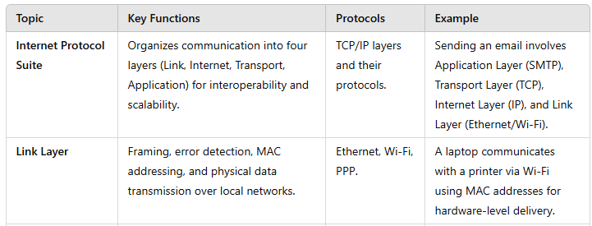
Summary Table

Slide 17
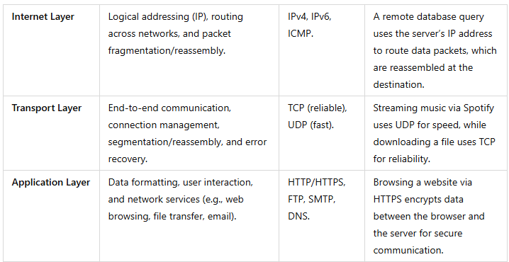
Summary Table

Slide 18
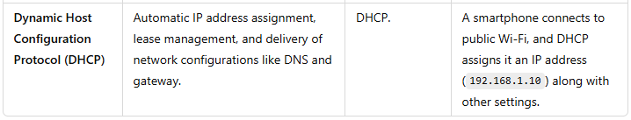
Summary Table

